Slide 1
Exploring the World Wildlife Fund (WWF)
Technology as a solution for climate change
Erasmus+KA229

Slide 2
WWF - Mission
"To conserve nature and reduce the most pressing threats to the diversity of life on Earth."
Goals
Protect endangered species and habitats, address climate change, and promote sustainable practices.

Slide 3
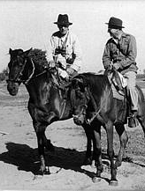
History of the World Wildlife Fund (WWF)
It was founded in 1961, emerged at a critical juncture in history when the world was becoming increasingly aware of the environmental challenges facing the planet. WWF was born out of the vision and dedication of a group of prominent conservationists and thinkers, including Sir Julian Huxley, Sir Peter Scott, and Prince Bernhard of the Netherlands.

Slide 4
History of the World Wildlife Fund (WWF)
These individuals recognized the urgent need to address the pressing threats to Earth's biodiversity and sought to create a global organization dedicated to the conservation of nature.

Slide 5
History of the World Wildlife Fund (WWF)
The iconic panda logo, designed by Sir Peter Scott, symbolized their commitment to protecting endangered species and their habitats. Since its inception, WWF has grown into one of the world's leading conservation organizations, working tirelessly to conserve nature, combat climate change, and promote sustainable practices on a global scale.

Slide 6
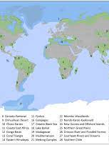
WWF's Global Presence

Slide 7
Protection of endangered species
WWF generates crucial data that inform evidence-based conservation strategies and advocates for regulations to safeguard vulnerable species collaborating with governments to create protected areas and establish sustainable practices. Furthermore, WWF focuses on habitat restoration, anti-poaching initiatives, and community engagement.

Slide 8
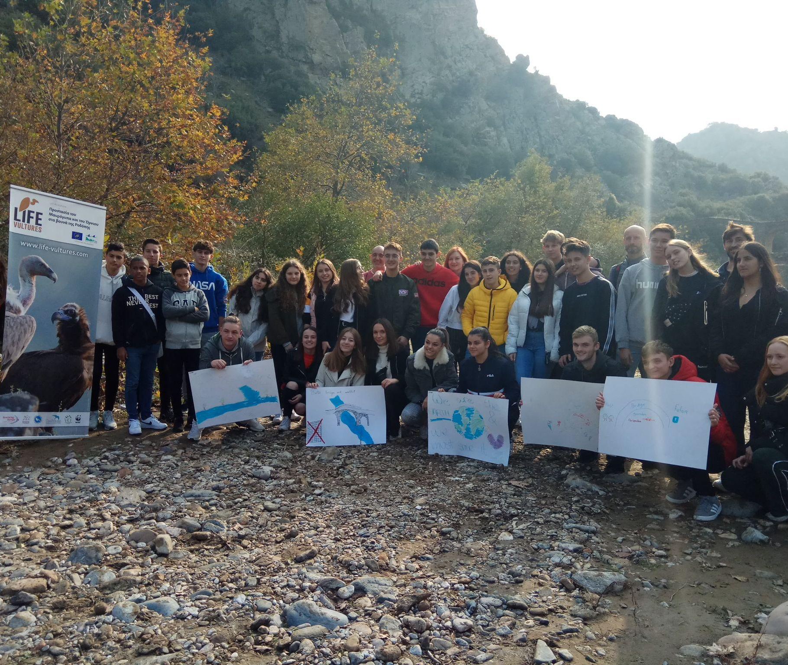
WWF in our region
In collaboration with WWF Hellas, Dadia branch, schools of Iasmos carry out actions on the banks of the Kompsatos river to raise awareness of the importance of the river valley in the management of the region's ecosystem and the rare Thracian Meteor Vultures.

Slide 9
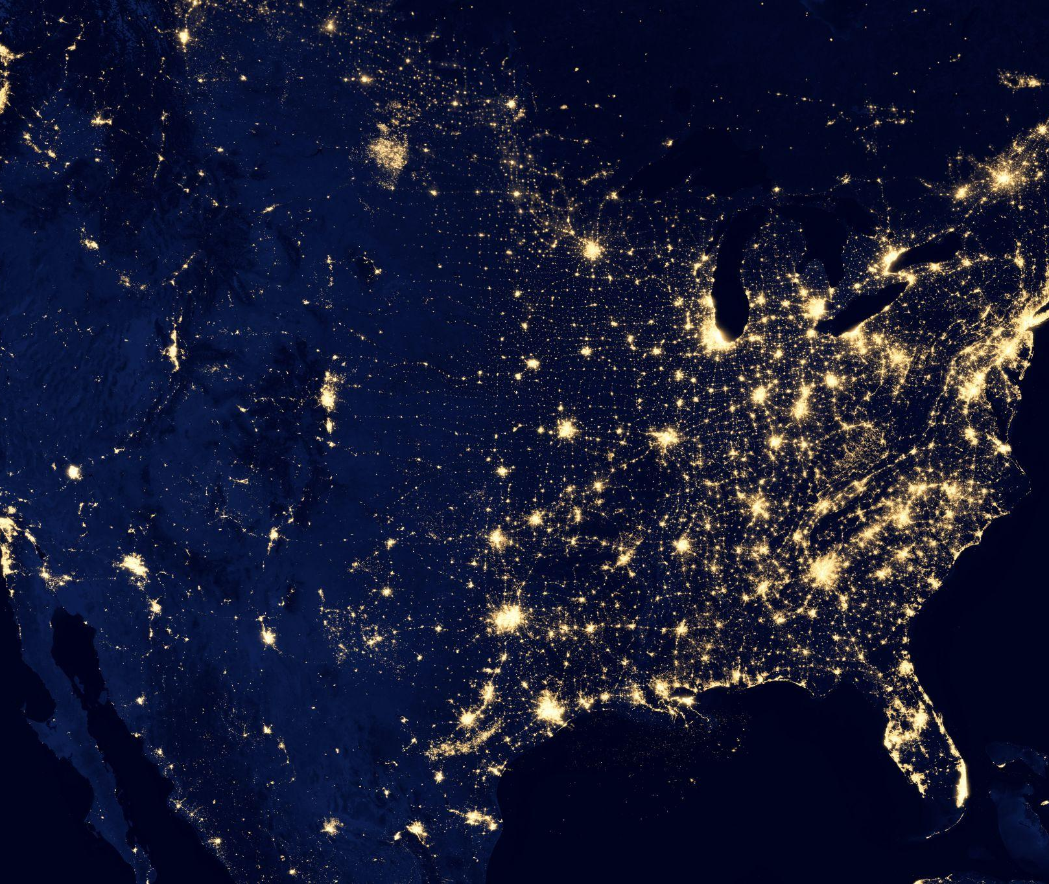
Climate Change Initiatives
WWF's Earth Hour is one of the world's global environmental movements, encouraging individuals, communities, and businesses to turn off non-essential lights for one hour as a symbolic act against climate change.

Slide 10
Sustainable Practices
WWF encourages forest certification systems like the Forest Stewardship Council (FSC) and the Programme for the Endorsement of Forest Certification (PEFC). These systems ensure that timber and other forest products come from responsibly managed forests.

Slide 11
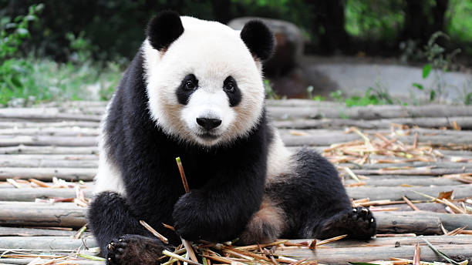
Conservation Success Stories
WWF's iconic panda logo is a symbol of its successful efforts to save the giant panda from extinction. Through conservation programs and habitat preservation in China, the giant panda population has increased, moving the species from "endangered" to "vulnerable" on the IUCN Red List.

Slide 12
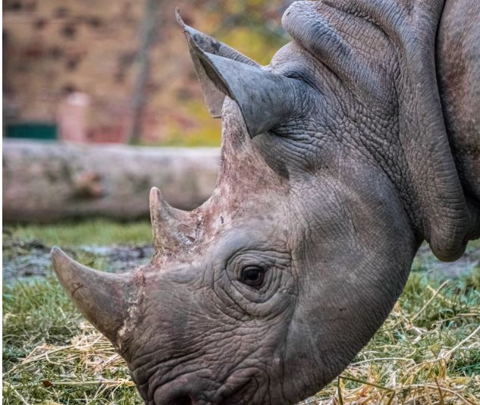
Conservation Success Stories
WWF has been instrumental in the conservation of black rhinos. In Namibia, they supported community-based conservation programs that led to a significant increase in the black rhino population.

Slide 13
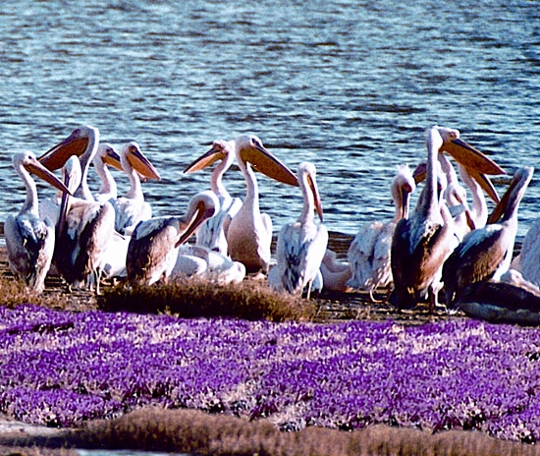
Threats to Wildlife
WWF support activities like establishing and managing protected areas, supporting sustainable resource management, conducting wildlife research, and engaging local communities in conservation practices.
WWF also influences the development of laws that protect the environment.

Slide 14
Fundraising and Support
WWF offers a range of flexible donation options. Joining WWF as a member is a powerful way to actively support conservation initiatives. It also offers diverse and engaging volunteer opportunities for persons eager to contribute their time and skills to conservation efforts.

Slide 15
Our donation
Adopt a penguin this Christmas 2022-a symbolic adoption

Slide 16
Thank you
Any questions?

