Slide 1
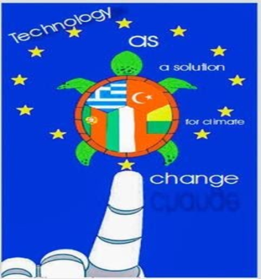
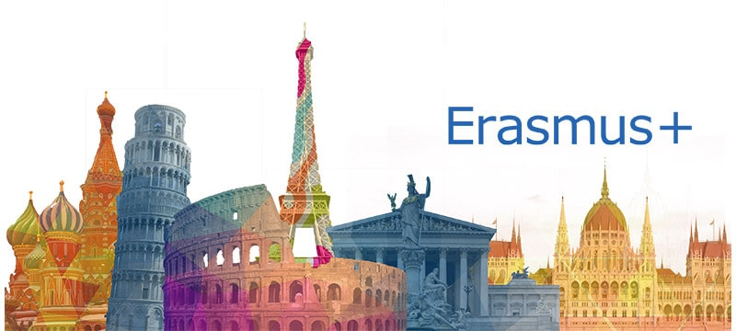

Slide 2
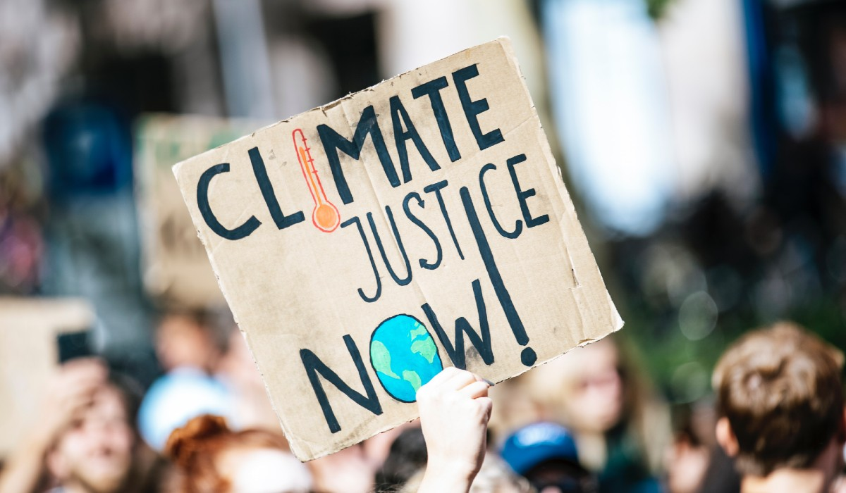
Climate Change and Justice

Slide 3
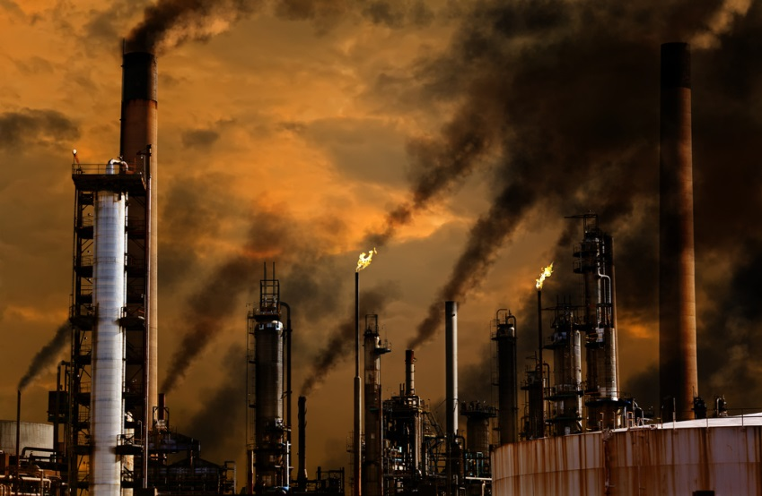
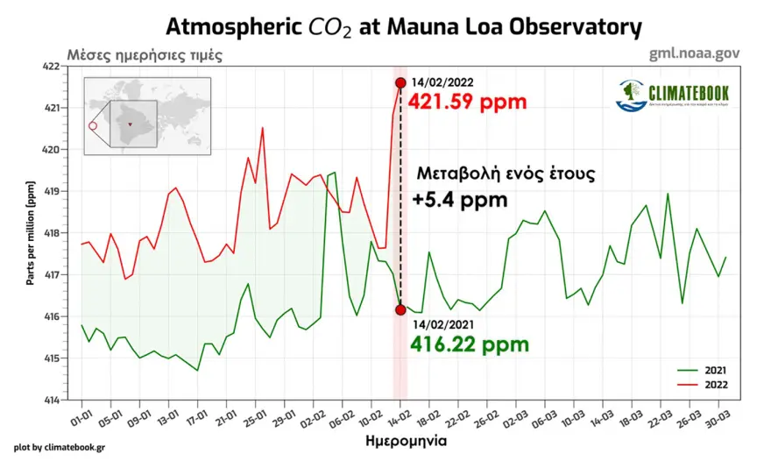
What is Climate Change?
Climate change describes a change in the average conditions in a region over a long period of time.

Slide 4
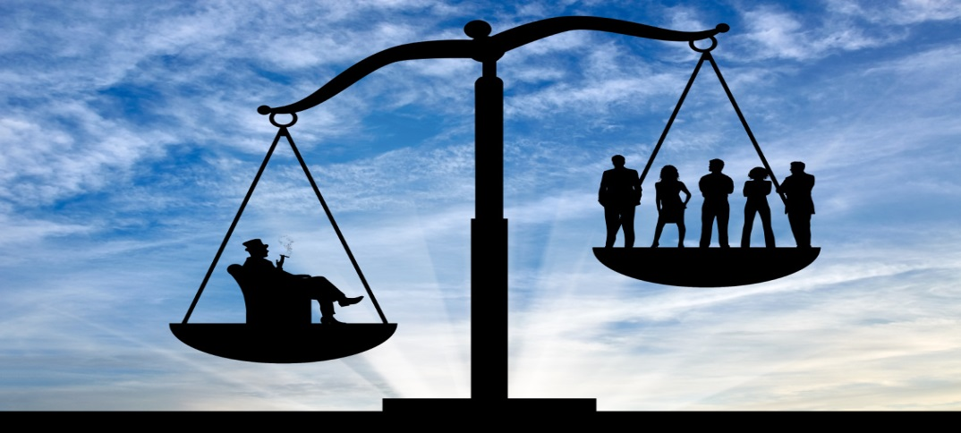
What is Climate Justice
Climate justice is a concept that addresses the just division, fair sharing, and equitable distribution of the benefits and burdens of climate change and responsibilities to deal with climate change.

Slide 5
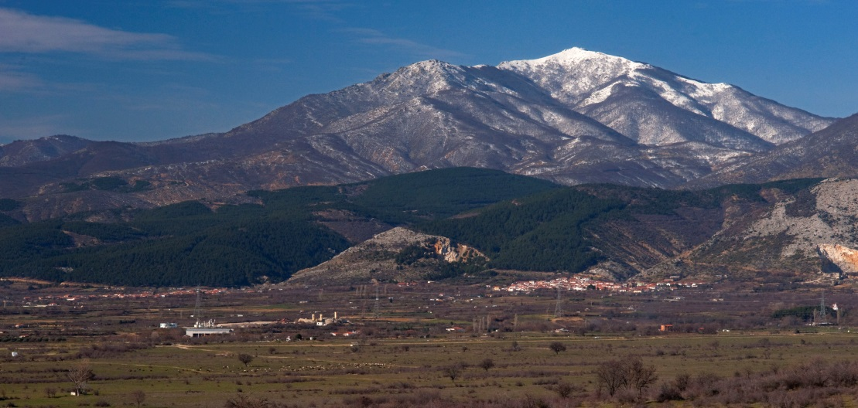
Climate change impacts in Greece
Climate projections for the Mediterranean suggest that the region will become warmer and drier with more frequent and extreme weather events. This presents a threat to urban areas in the form of increased risks for flash floods and heatwaves.
Water will be seduced so dehydration will start increasing in Greek forests.

Slide 6
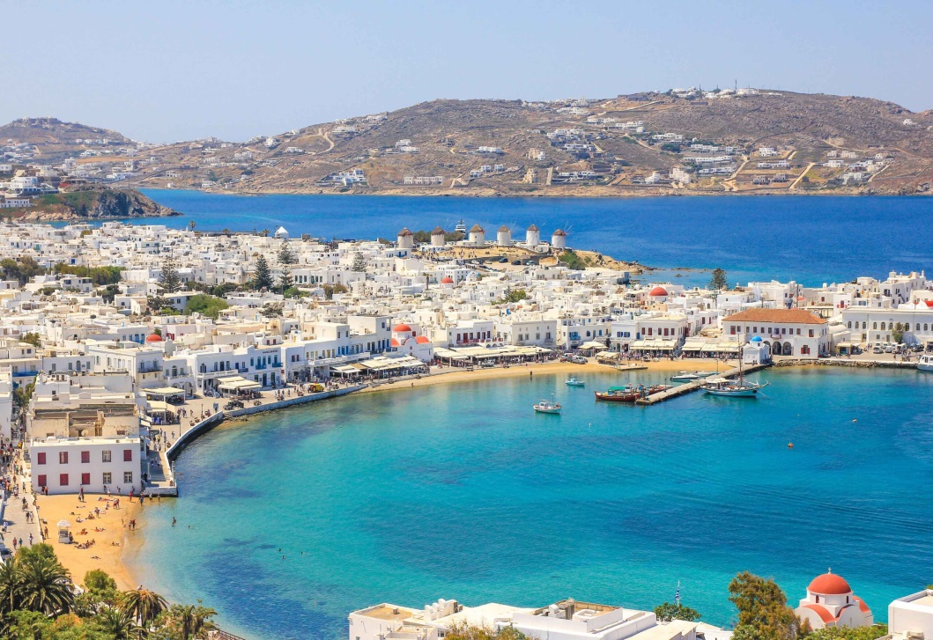
The Mediterranean Region
The Mediterranean region is particularly vulnerable to climate change, as it is particularly sensitive to drought and rising temperatures.

Slide 7
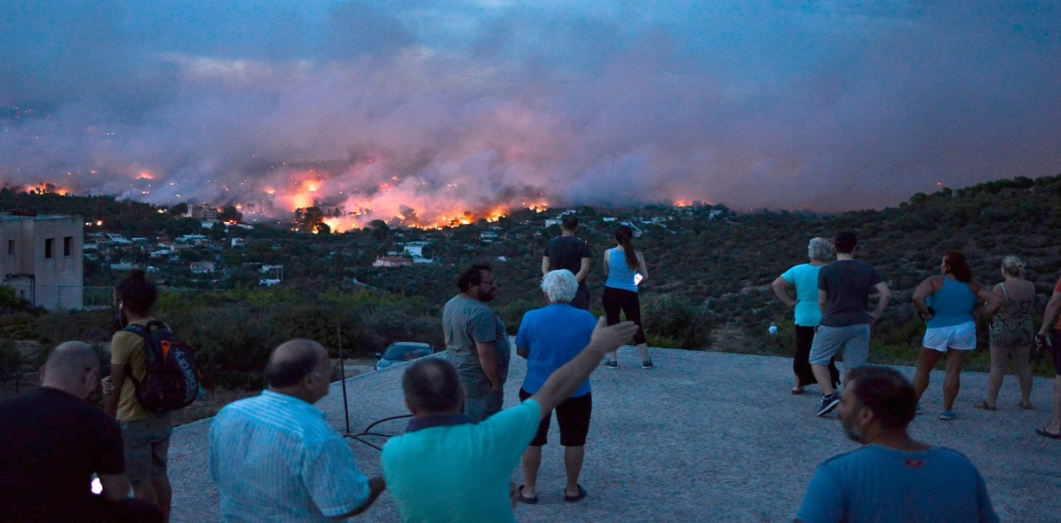
Forests in Greece
Forests in Greece are under danger of dehydration and getting fired.
Recently, a near forest which our school is located near, caught fire and the near villages almost had the chance to be destroyed.

Slide 8
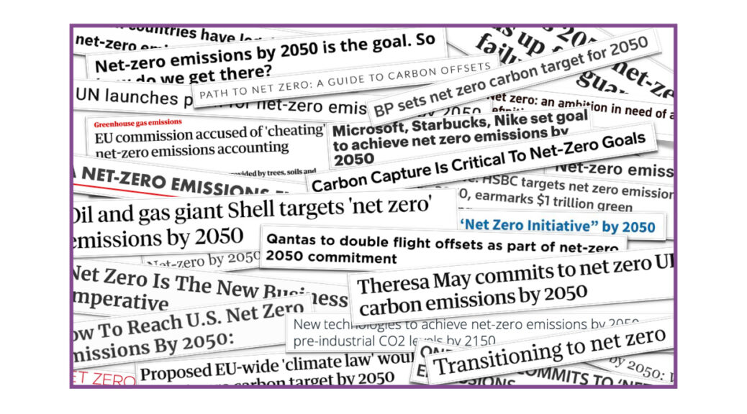
Social Consequences
As the climate continues to change, extreme events, health impacts, food, water and livelihood security, migration and displacement, loss of cultural identity and other related risks will impact millions of poor people.

Slide 9
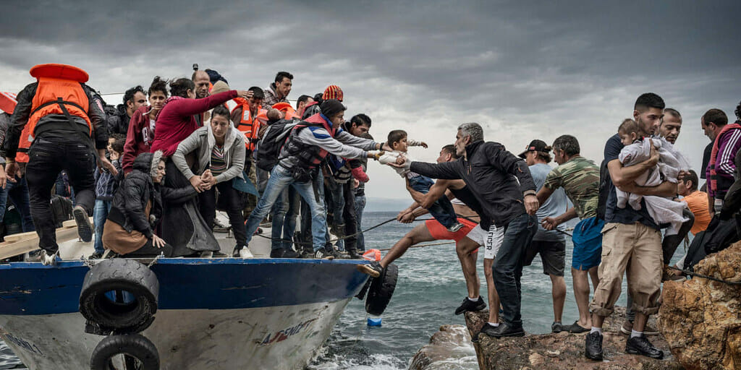
Social impacts
Poor households, minorities and immigrants already living in deprivation and facing significant environmental and social problems, not to mention inadequate access to social and health services, will see their situation deteriorate further in terms of housing, food, health, education and access to basic services.

Slide 10
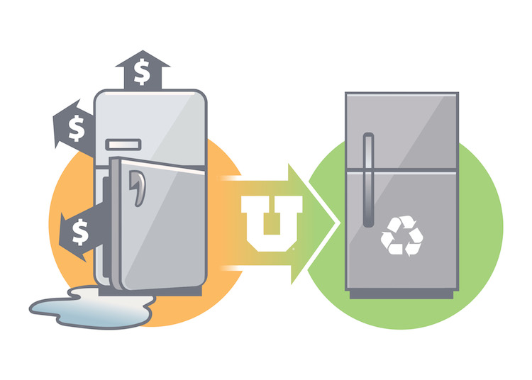
Equally questionable will be their ability to join energy-saving programmes, purchase advanced technology equipment and pay more for cleaner energy, as would be required under a policy for reducing greenhouse gas emissions. Poorer householders will not adapt to these kind of programmes due to the high price of new technologies.

Slide 11
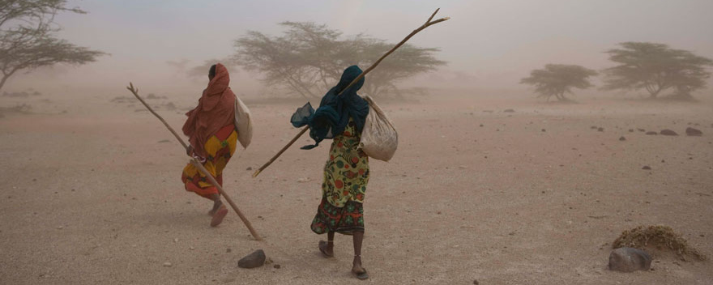
Social Impacts
The risk of a vicious cycle of poverty, lack of access to energy and technologies, and limited protection against losses induced by climate change is therefore real and is expected to lead to an exacerbation of phenomena commonly referred to in the literature as ‘energy poverty’ and ‘climate poverty’.

Slide 12
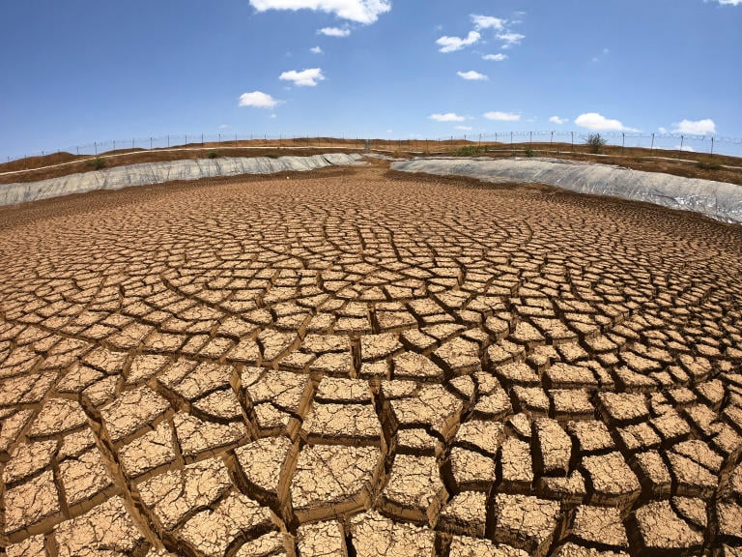
Social Impacts
Thus, just as with social groups, economically weaker countries will be more vulnerable to the impacts of climate change that have already begun to be felt. Extreme weather events like drought, tropical storms and storm surges, but also the gradual sea level rise due to climate change, will be a matter of increasing concern to the international scientific community in the future.

Slide 13
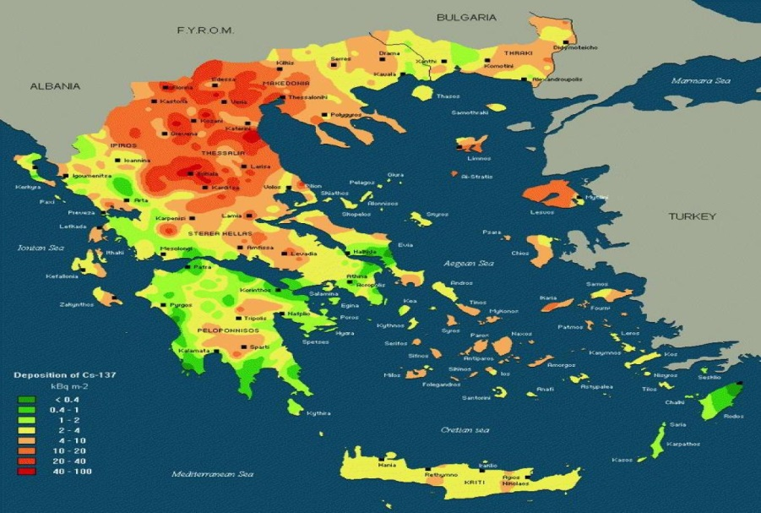
Social Impacts
Greece has already received large numbers of immigrants, and these numbers will increase significantly in future as the flow of environmental refugees increases.

Slide 14
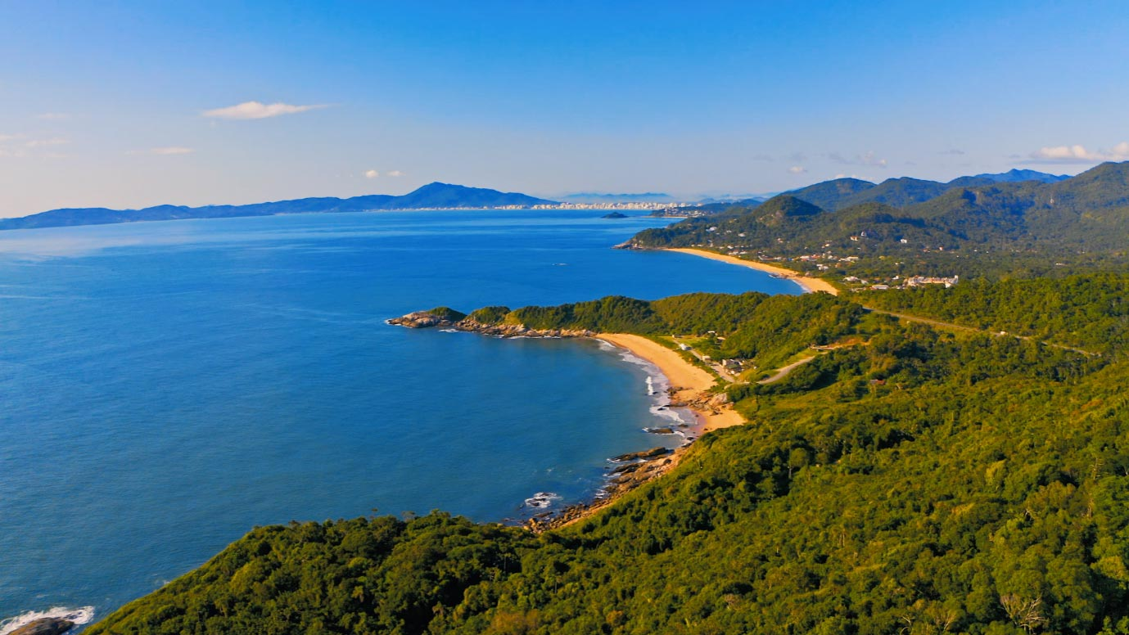
Social Impacts
In the meantime, internal migration from low-lying coastal areas to higher altitudes will obviously also have become an issue, thereby pointing to the serious need for further investigation, based on which adequate policy can be formulated.

Slide 15
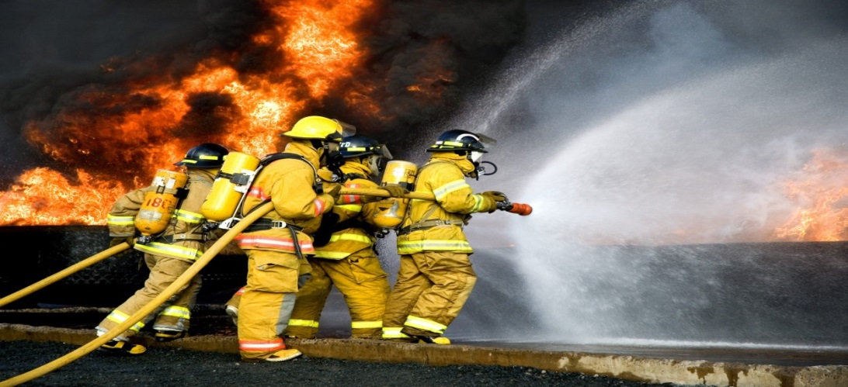
The Effects of Climate Change on the Greek Economy
As most forests are in need of rescue firefighters need more water to do their jobs.
Indeed, firefighters are economically helped by the country so if country doesn’t have the opportunity, then the forests still be in danger.

Slide 16
What should be done?
The transformation of low carbon emission model in economy by 2050.
Schedule of new plans in economy in suffering places.
Getting ready in big places such as Athens and Thessaloniki where the carbon emissions are extremely high.
Educating children about climate change and its effects on economy.

